Slide 1
Tsugi Progress Towards the NGDLE
Dr. Charles Russell Severance
Clinical Professor, University of Michigan School of Information
www.tsugi.org

Slide 2

www.sakaiger.com/sakaicar
Next race:
June 27-28
Photo: Jeffrey Smith

Slide 3
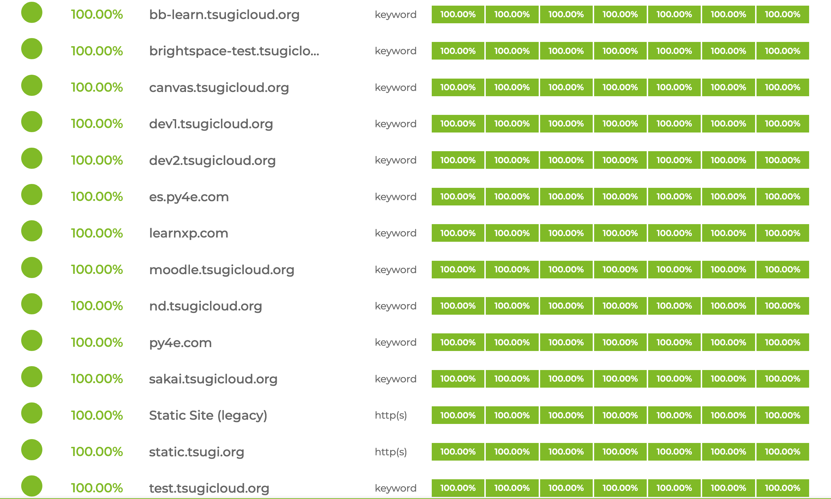
Tsugi Servers – status.tsugi.org

Slide 4








IMS LTI Advantage® IMS Deep Linking® IMS Common Cartridge®
PY4E /
次Tsugi

Slide 5
What is Tsugi?
Learning Application Development Framework
Standards Compliance / LMS Integration Libraries
Learning App Store
Hosting / Hosted services for Tools
Koseu
DIY Publishing
Learning Object Repository
MOOC Hosting Platform

Slide 6
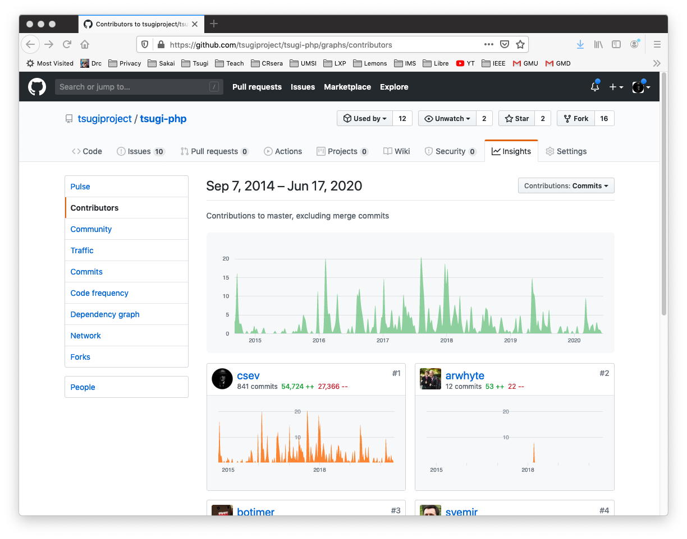

Slide 7
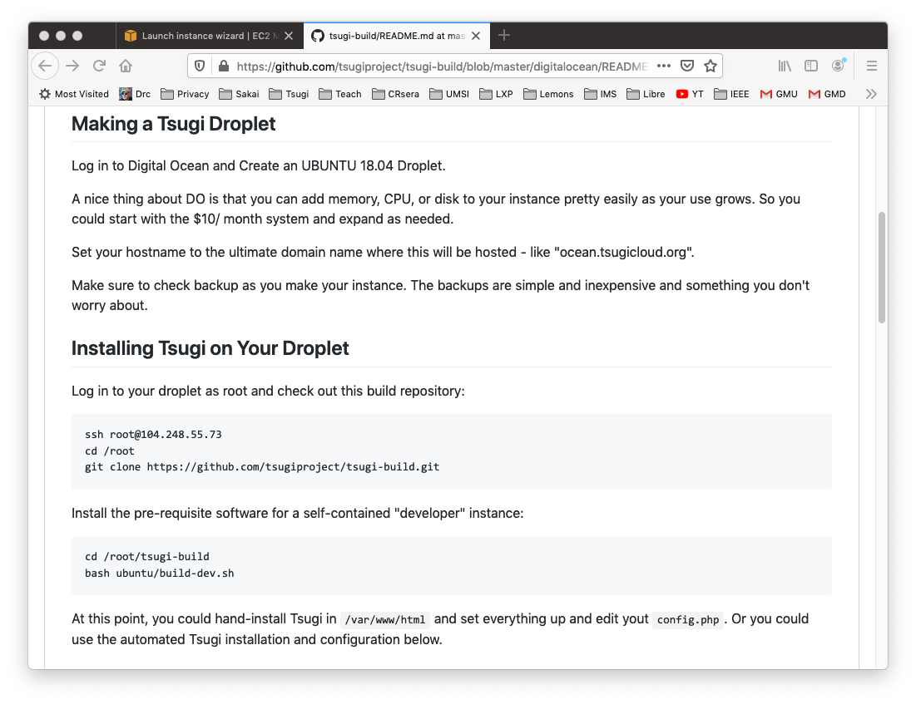

Slide 8
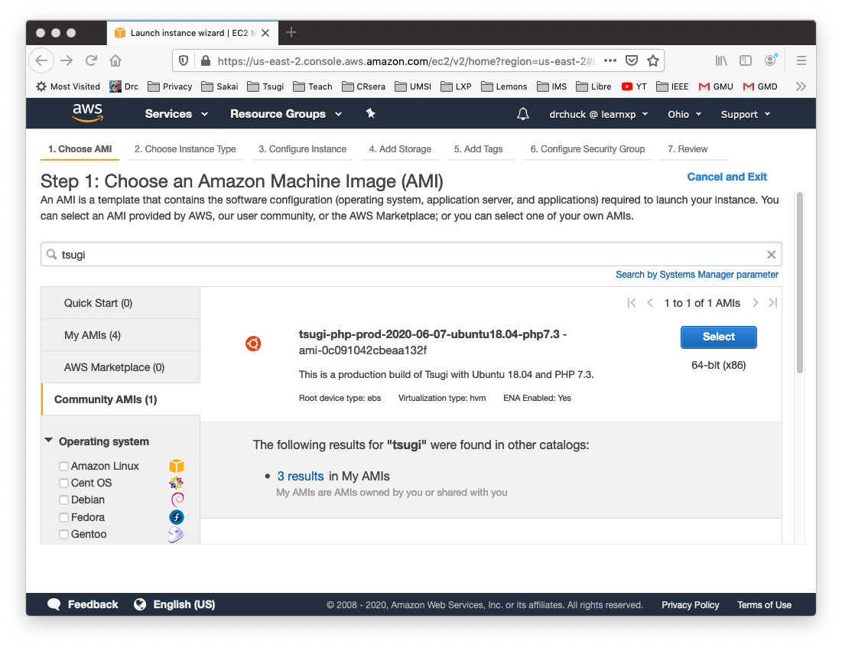

Slide 9
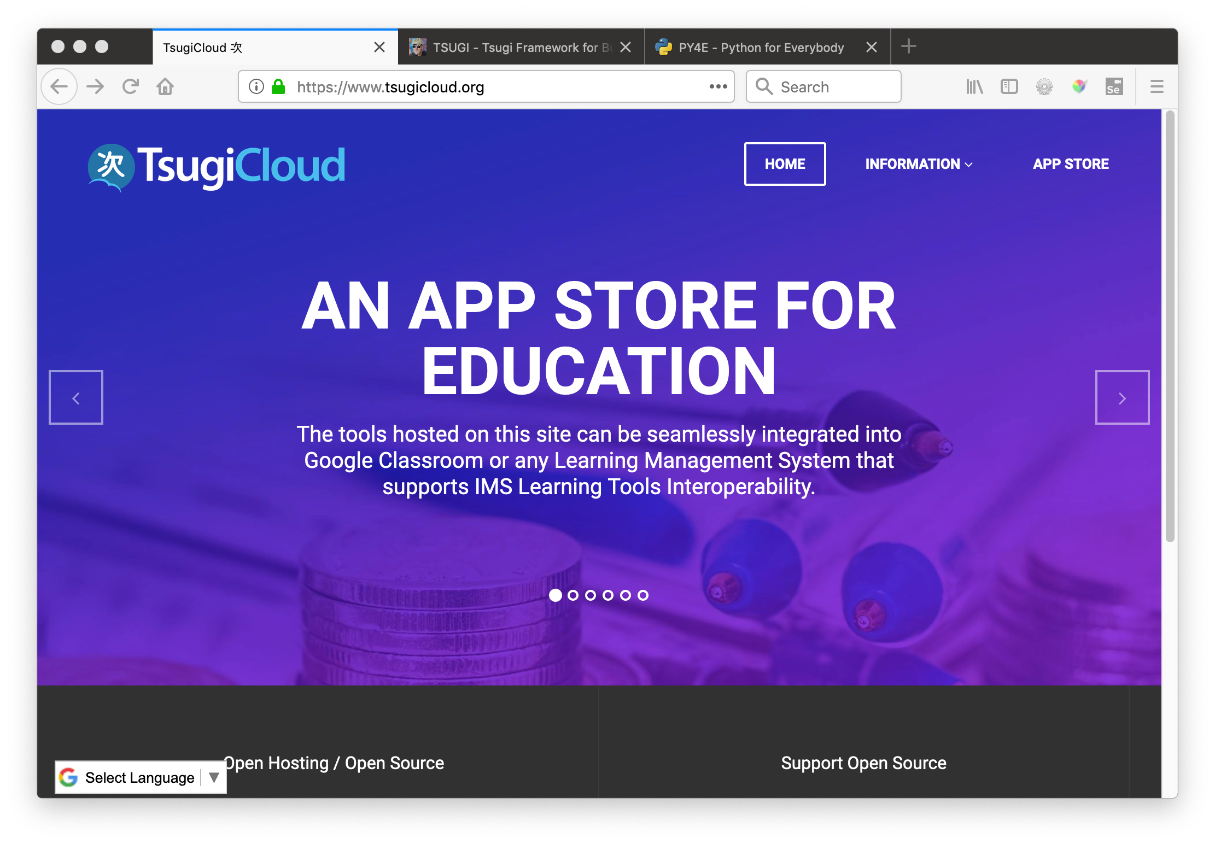

Slide 10
Recent Tools on tsugicloud.org
Topic Selector (*)
Pre / Post Reflection (*)
Chat / Web Sockets
Attendance Tool Upgrade (*)
Flash Cards (*)
Photo Gallery (*)
CKEditor Paper + Annotations
PDF Annotation
Interactive Video (*)
Quick Write Upgrade (*)
Quizzes UI Upgrade / QTI Export (*)
* Community Contribution

Slide 11
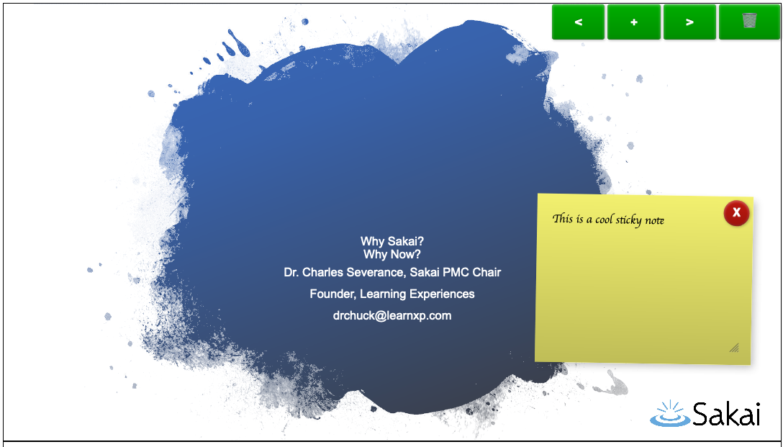
https://www.tsugicloud.org/tsugi/store/details/stickygrader

Slide 12
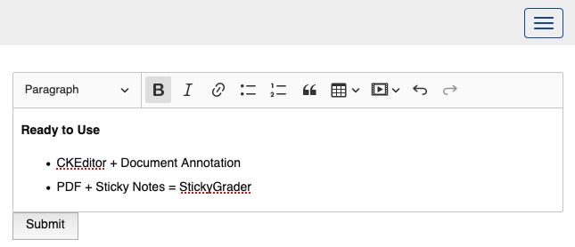
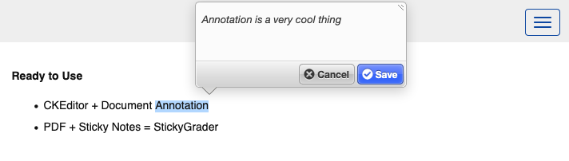
https://www.tsugicloud.org/tsugi/store/details/ckpaper

Slide 13
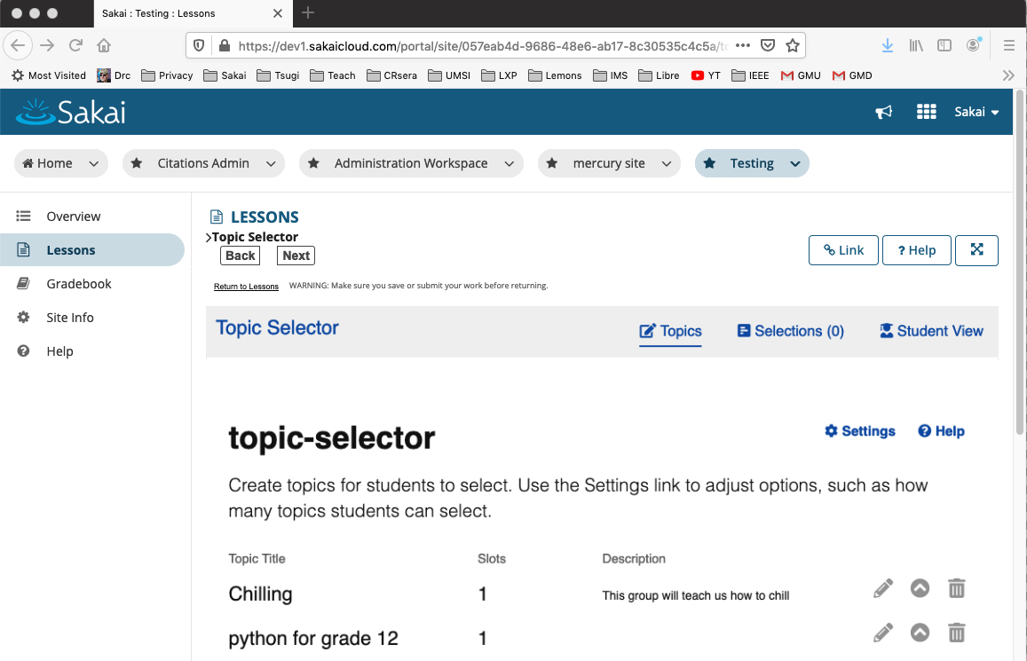
New Themed UI: Thanks to David Bauer

Slide 14
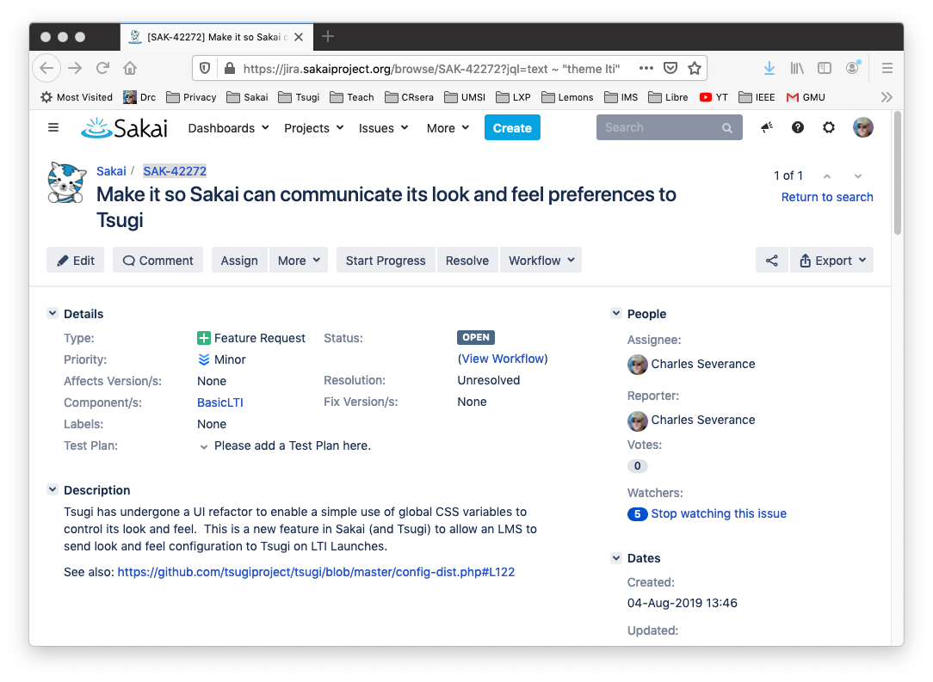
SAK-42272

Slide 15
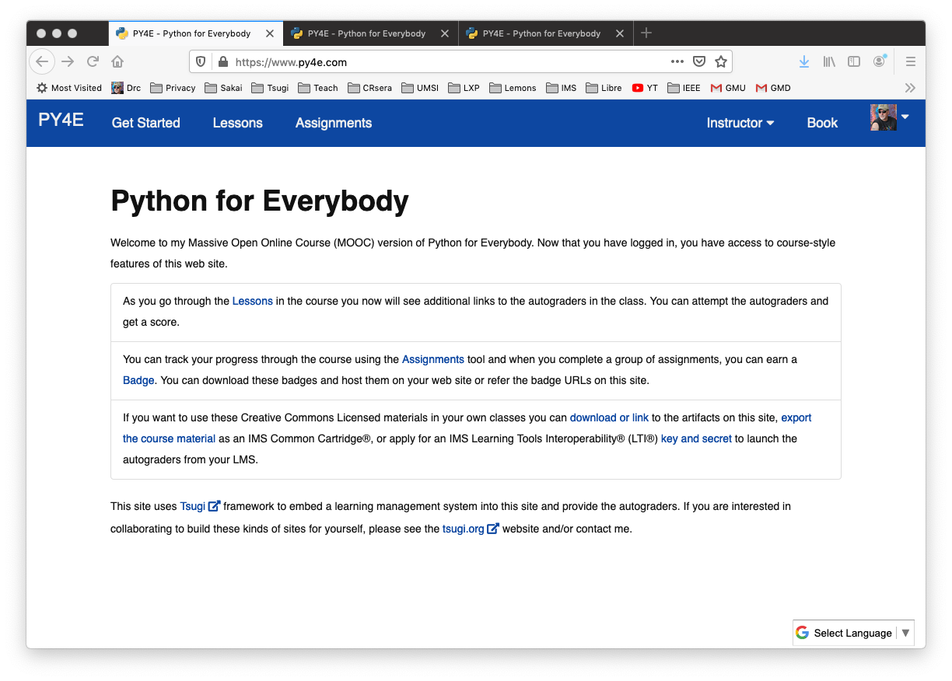

Slide 16
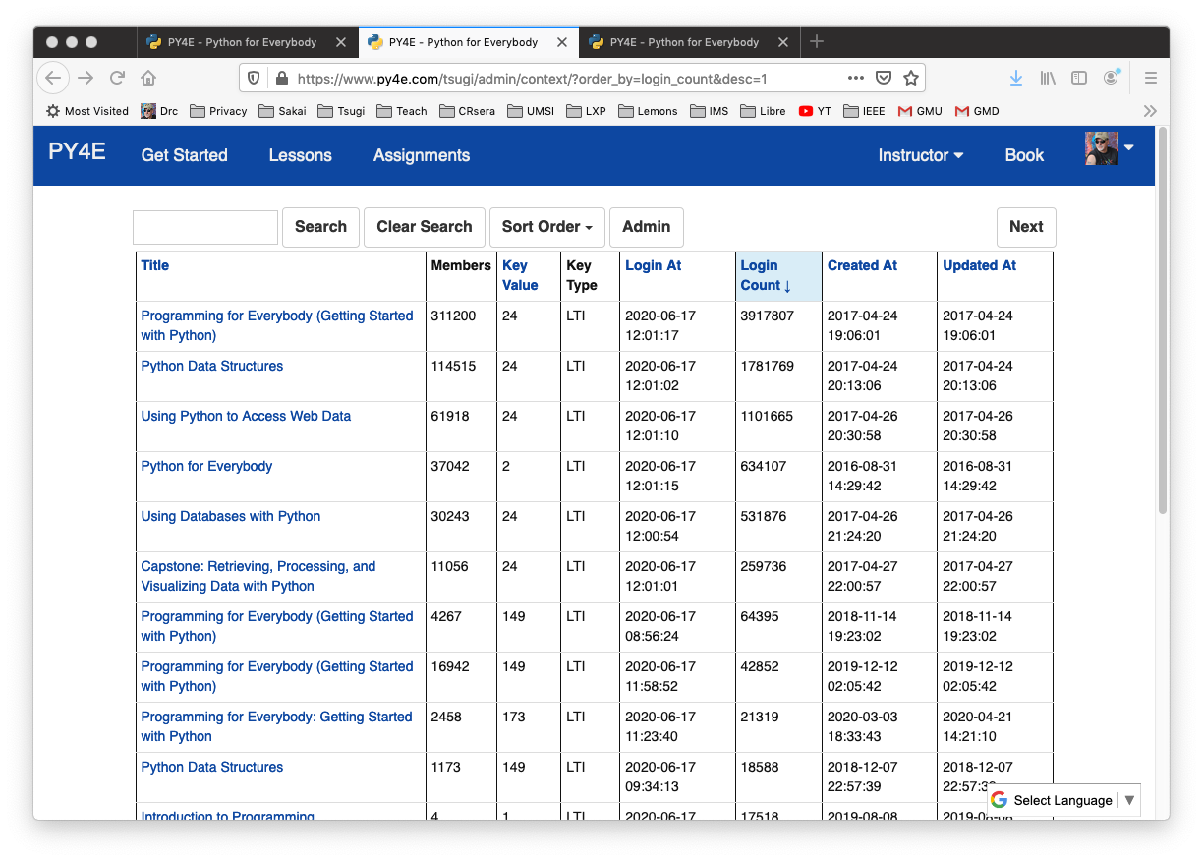
Performance and Scale

Slide 17
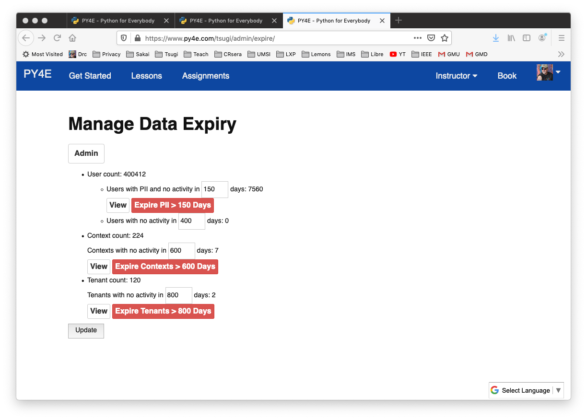

Slide 18




LTI 1.0
LTI 1.1
LTI Advantage
Google Classroom
Tsugi
JWT Launch
RPC API
LTI 2.0 is *gone* - Sakai too

Slide 19
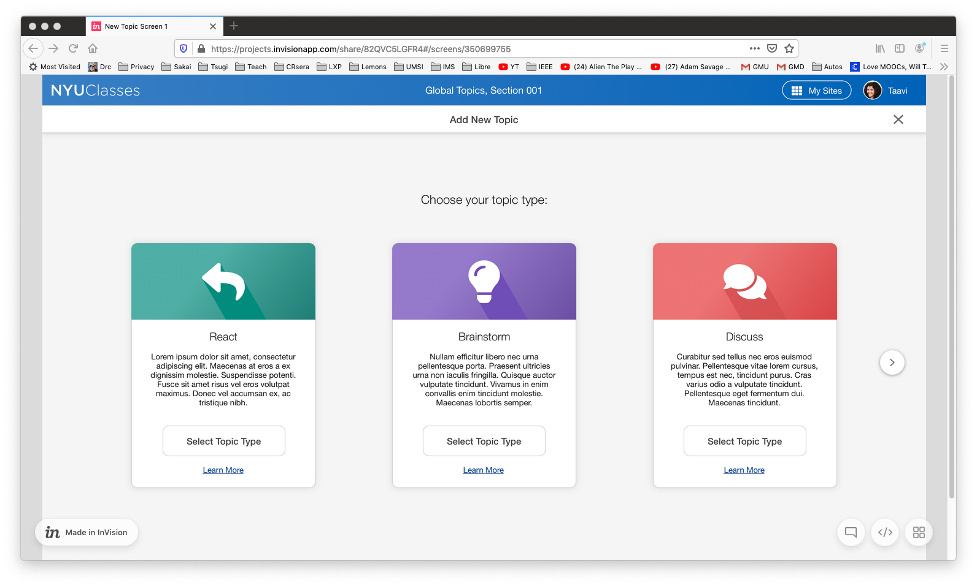

Slide 20
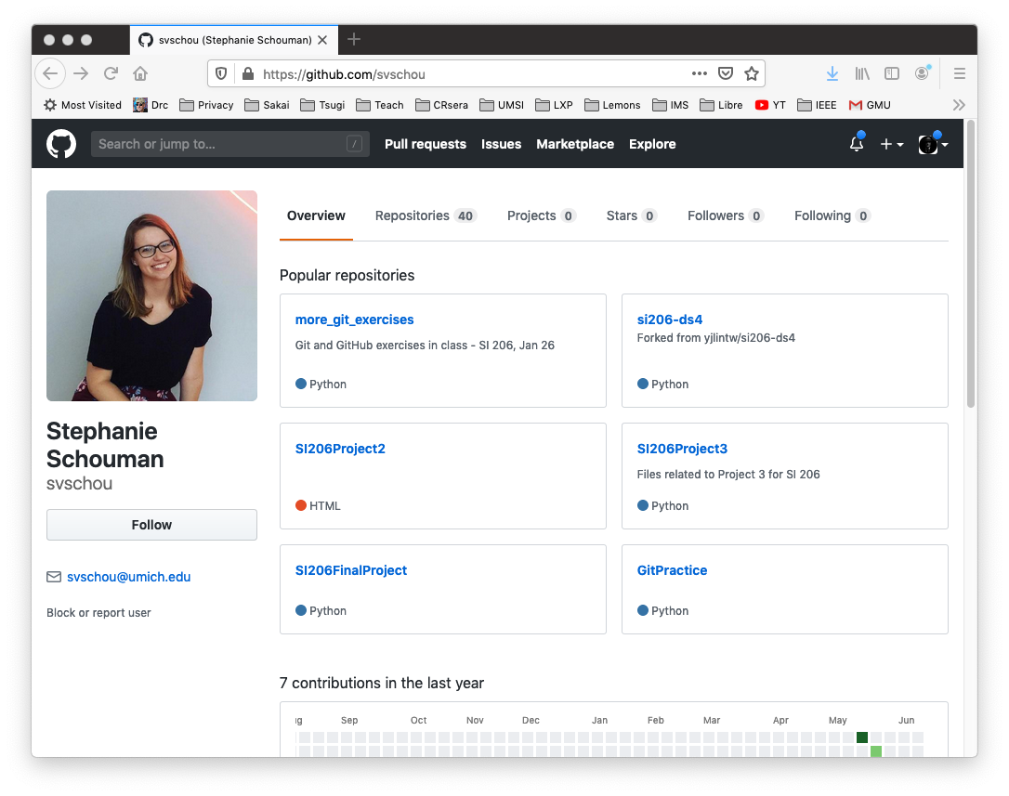

Slide 21
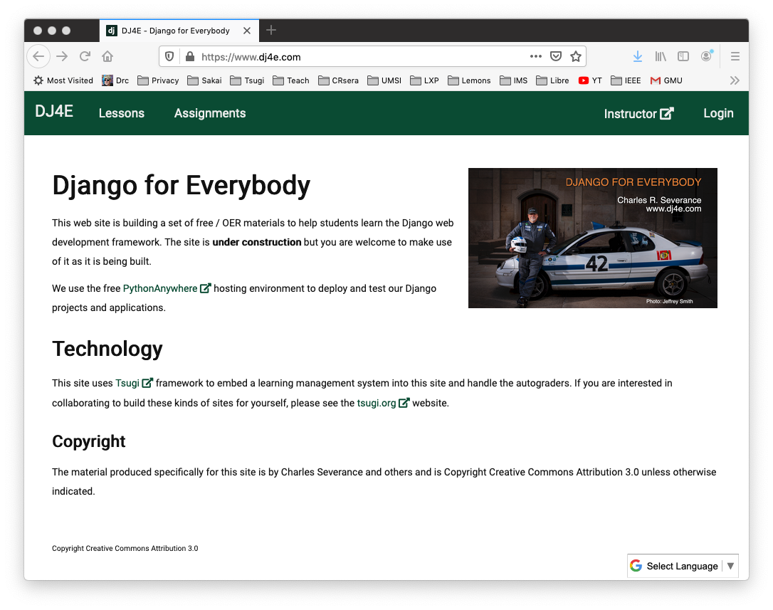
July 22: Coursera Summer/Fall: edX FutureLearn

Slide 22
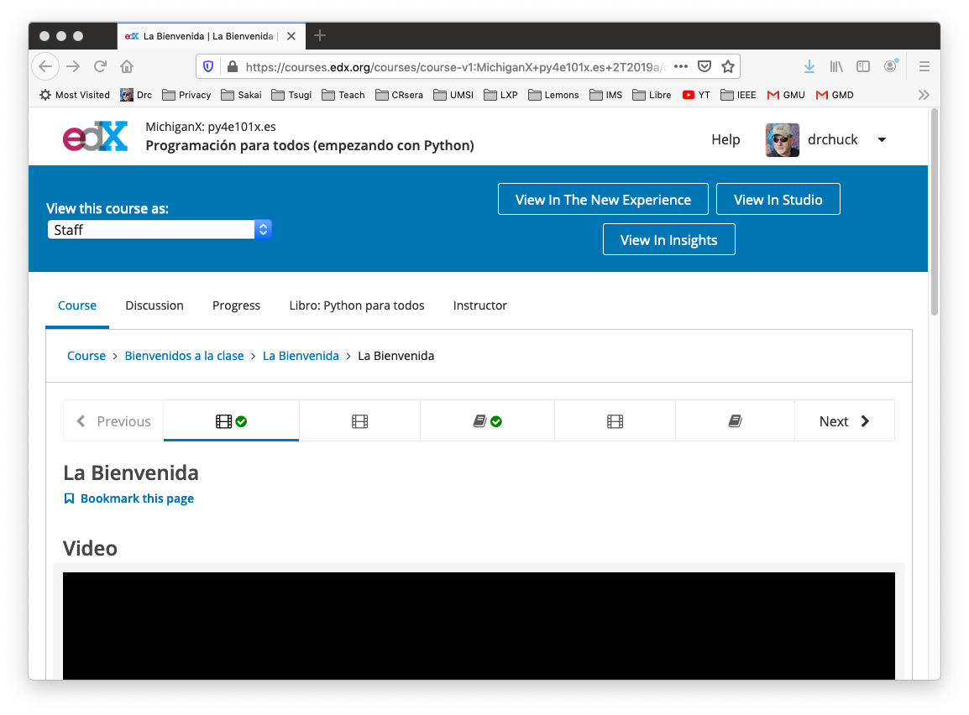

Slide 23
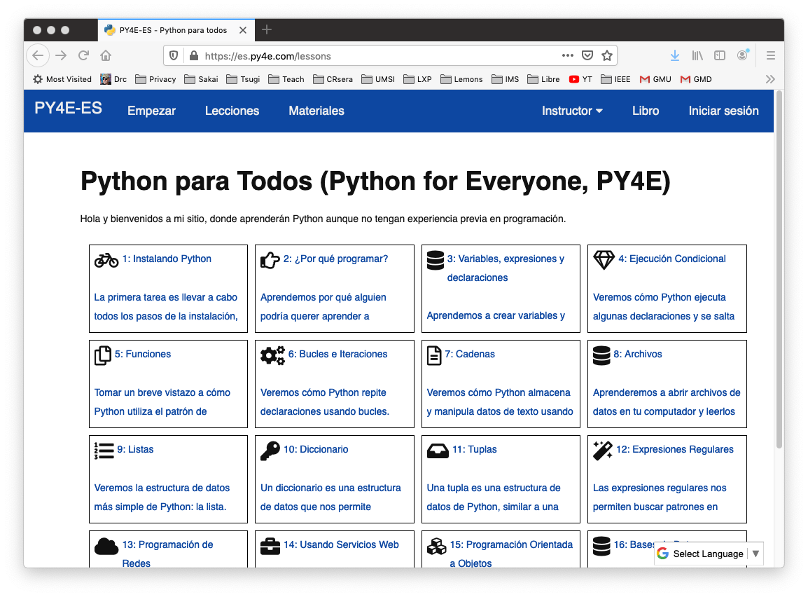
Koseu DIY Publisher

Slide 24
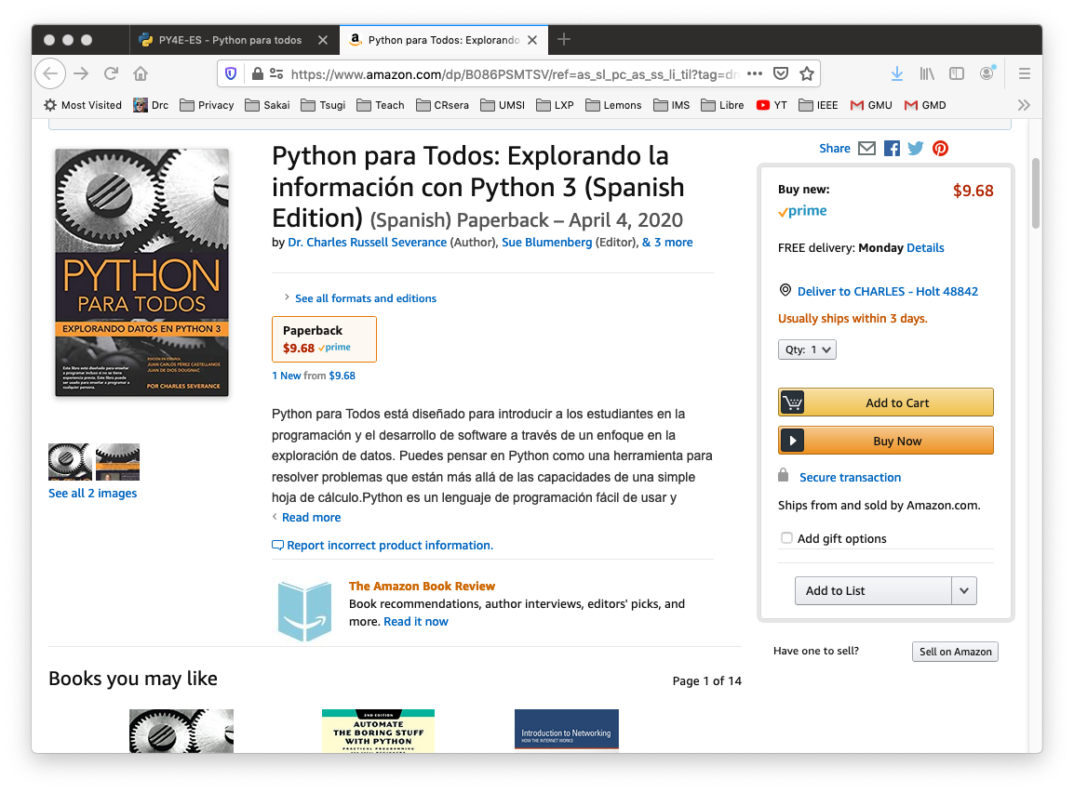
Koseu DIY Publisher

Slide 25



TODO: Make Publisher Back End Usable
LTI Apps
Pages
Files
Graders
Book
LOR/MOOC py4e.com
Autograders (次)
Modules
OER Content (코스)
IMS
Canvas
edX
Pandoc
Coursera
KDP
Media
FutureLearn
archive.org
YouTube
Amazon
ITunes
Google Play

Slide 26
References
Web Site - https://github.com/tsugiproject/tsugi-org
Tsugi UI - https://github.com/tsugiproject/tsugi
Tsugi PHP Library - https://github.com/tsugiproject/tsugi-php
Tsugi Hosting - https://github.com/tsugiproject/tsugi-build
Koseu – LMS / Learning Object Repository
Python for Everybody - https://github.com/csev/py4e
Web Applications for Everybody - https://github.com/csev/wa4e

Slide 27
Questions

